Slide 1
Handling Adversarial Attacks on Deep Neural Network through Change Point Detection Application to Smart Home Time Series Data
PROJECT PROPOSAL PRESENTATION
CSE 419 Section -02 Fall 2019

Slide 2
Team Members
Name | ID
Mahbuba Tasmin | 1610064042
Sharif Uddin Ruman | 1611557642
Sifat Jahan | 1611702642
N.M. Shihab Islam | 1420339042
Abdur Raufus Saleheen | 1610472642
Taoseef Ishtiak | 1612142042
Md. Sajid Ahmed | 1610364042
Arif Suhan | 1610437042
Shahnawaz Zulminan | 1611708042

Slide 3
Adversarial Attacks on Deep Neural Networks for Time Series Classification
Authors - Hassan Ismail Fawaz, Germain Forestier, Jonathan Weber, Lhassane Idoumghar and Pierre-Alain Muller
-IRIMAS, University Haute-Alsace, Mulhouse, France
Publication Journal - IEEE International Joint Conference on Neural Networks - (IJCNN) 2019{7.426}
Dataset Source: https://www.cs.ucr.edu/~eamonn/time_series_data/UCR_TS_Archive_2015.zip
Dataset Name - UCR_TS_Archive_2015

Slide 4
Abstract
Abstract— Time Series Classification (TSC) problems are contained in many real-life data mining activities ranging from medication and health to identification of human activity and food safety.
They propose to leverage existing adversarial attack mechanisms to add a special noise to the input time series in order to decrease the network’s confidence when classifying instances at test time.

Slide 5
Introduction
An adversarial attack consists in modifying an original image so that the changes are almost undetectable by a human. The modified image is called an adversarial image, which will be misclassified by the neural network, while the original one is correctly classified.
Another application is the alteration of illegal content to make it undetectable by automatic moderation algorithms.
Transfer and adapt adversarial attacks that have been shown to work well on images to time series data.

Slide 6
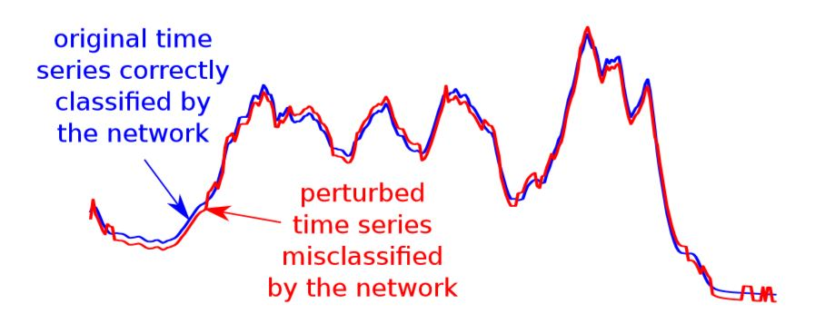
Example
Fig: Example of a perturbed time series that is misclassiﬁed by a deep network. (Coffee)

Slide 7
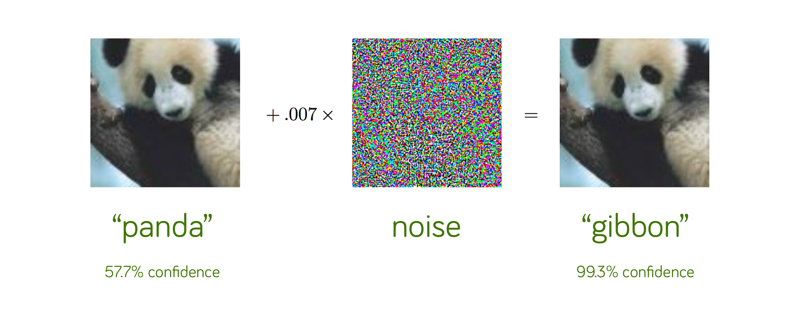
Example

Slide 8
Methodology
Residual Network (ResNet) was used for adversarial attacks for time series.
Two attack method was used to generate adversarial time series.
Fast Gradient Sign Method (FGSM)
Basic Iterative Method (BIM)

Slide 9
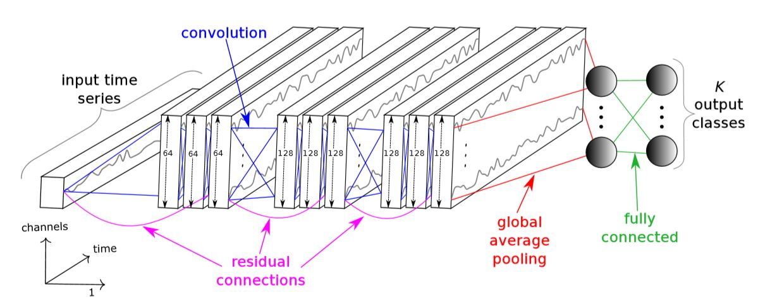
Residual Network
Fig: The deep Residual Network architecture for Time Series Classification.

Slide 10

Fast Gradient Sign Method (FGSM)
This adversarial method fooled GoogLeNet model.
This attack is based on a one step gradient update along the direction of the gradient’s sign at each time stamp.

Slide 11
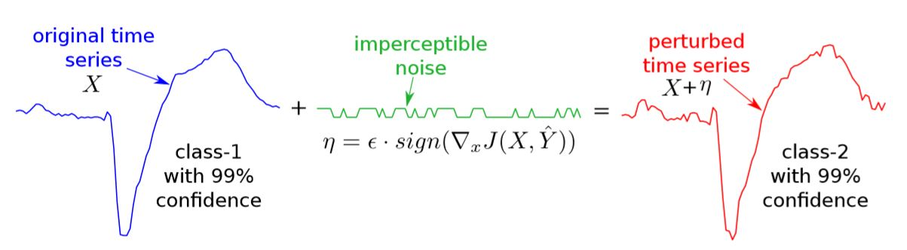
Approach with FGSM
Fig : Example of perturbing the classiﬁcation of an input time series from a dataset (TwoLeadECG ) by adding an imperceptible noise computed using the Fast Gradient Sign Method (FGSM).

Slide 12
Basic Iterative Method
Basic Iterative Methods (BIM) extends FGSM by applying it multiple times with a small step size.
By adding smaller changes in an iterative meaner generates adversarial time series.
Generated series examples was closer to original time series.

Slide 13
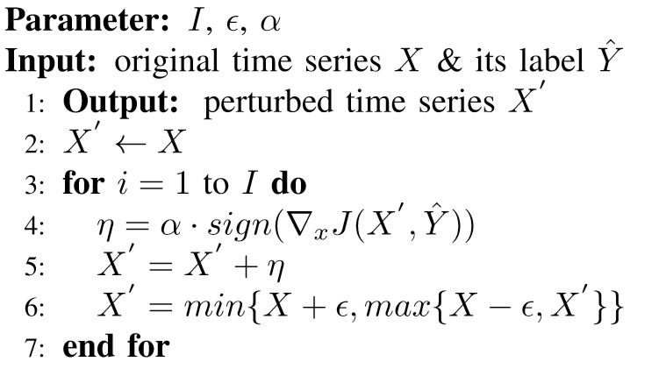
Iterative Adversarial Attack

Slide 14
UCR Archive
Total 85 different Dataset on Time Series Classification.
Ham
Coffee
FordA
SmallKitchenAppliances
……………..………..
………………………..
84. LargeKitchenAppliances
85. ItalyPowerDemand

Slide 15
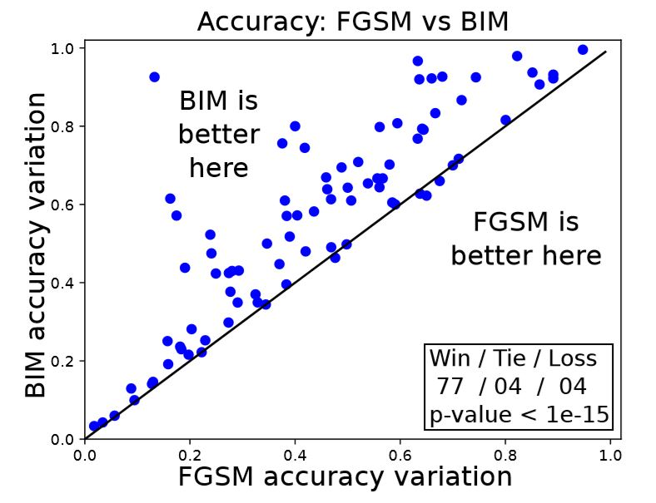
Result and Finding
Result on whole UCR archive:
Fig: Accuracy variation of two attack.

Slide 16
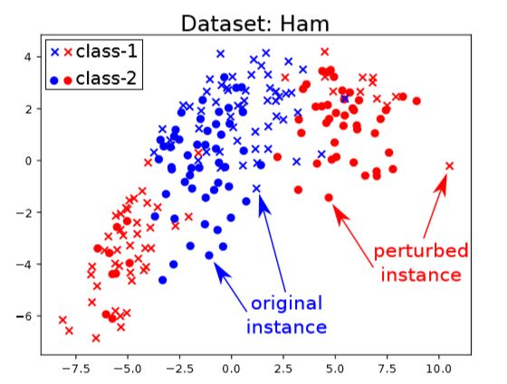
Attacks on food quality and safety(HAM)
Fig: Multidimensional Scaling (MDS) showing the distribution of perturbed time series.

Slide 17
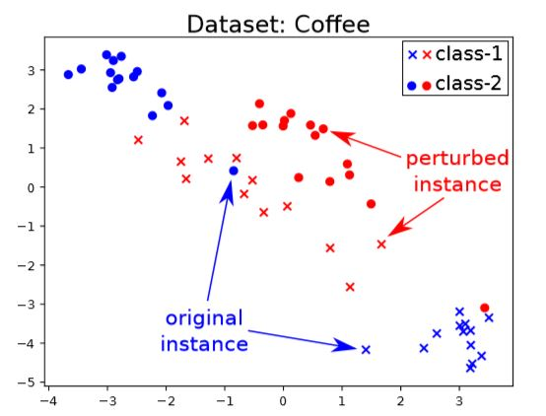
Attacks on food quality and safety(Coffee)
Fig: Multidimensional Scaling (MDS) showing the distribution of perturbed time series.

Slide 18
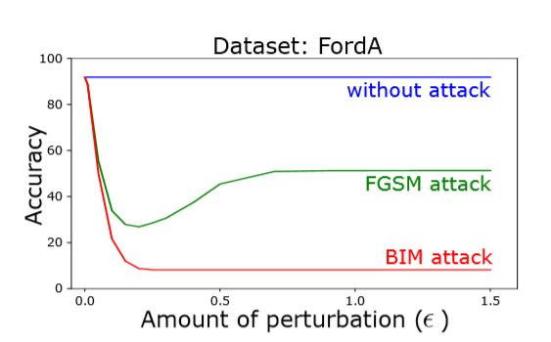
Attack on vehicle sensors(FordA)
Attack | Accuracy
ResNet_Original | 91.8
ResNet_FGSM | 33.9
ResNet_BIM | 21.6
Fig : FGSM and BIM attack on FordA

Slide 19
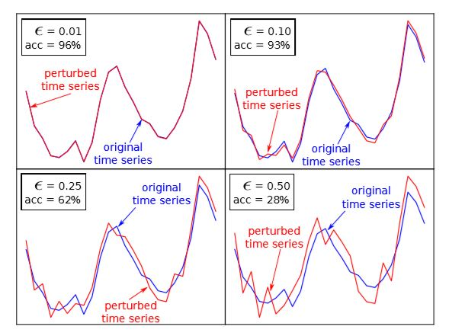
Attack on electricity consumption (ItalyPowerDemand)
Fig: Accuracy variation for ItalyPowerDemand

Slide 20
Evaluation against FCN
Dataset | ResNet Original | ResNet FGSM | ResNet BIM | FCN Original | FCN FGSM | FCN BIM
Ham | 80.0 | 21.0 | 20.0 | 71.4 | 27.6 | 27.6
Coffee | 100.0 | 50.0 | 35.7 | 100.0 | 75.0 | 64.3
FordA | 91.8 | 33.9 | 21.6 | 90.1 | 59.6 | 57.3
SmallKitchenAppliances | 78.9 | 40.5 | 21.9 | 78.7 | 47.5 | 28.8
LargeKitchenAppliances | 90.4 | 74.7 | 65.3 | 89.6 | 66.4 | 63.5
yoga | 87.2 | 45.4 | 12.8 | 84.1 | 44.9 | 19.2
ItalyPowerDemand | 95.9 | 92.5 | 91.6 | 96.1 | 89.8 | 89.6
Fig: Evaluation of ResNet against FCN (7/85 Dataset)

Slide 21
Real-Time Change Point Detection with application to Smart Home Time Series Data
Authors - Samaneh Aminikhanghahi, Tinghui Wang, and Diane J. Cook, IEEE Fellow
Publication Journal - IEEE Transactions on Knowledge and Data Engineering (3.865)
Dataset Source- CASAS ( Center of Advanced Studies in Adaptive System)
Dataset Name - Human Activity Recognition from Continuous Ambient Sensor Data Dataset

Slide 22
Abstract
Change Point Detection (CPD) is the problem of discovering time points at which the behavior of a time series changes abruptly.
A novel real-time nonparametric change point detection algorithm called SEP (Separation distance as a divergence measure to detect change points in high-dimensional time series).
Index Terms—Activity transition detection, change detection algorithms, Separation distance, smart homes, time series data

Slide 23
Introduction
Direct density ratio change point detection algorithms
Detect change points between two consecutive windows of data by estimating their probability density ratio based on the assumption that the probability density of two consecutive windows are same if they belong to the same state.
Introduction of new CPD method built on the notion of SEParation distance

Slide 24
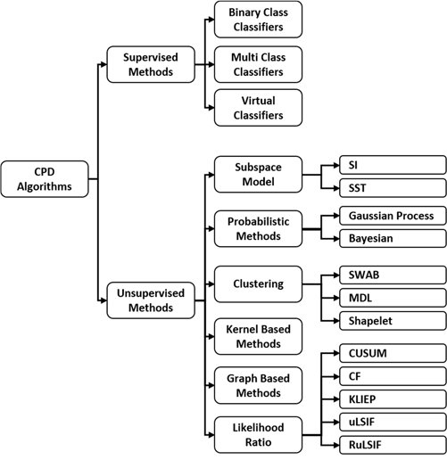
Overview of CPD Algorithms

Slide 25
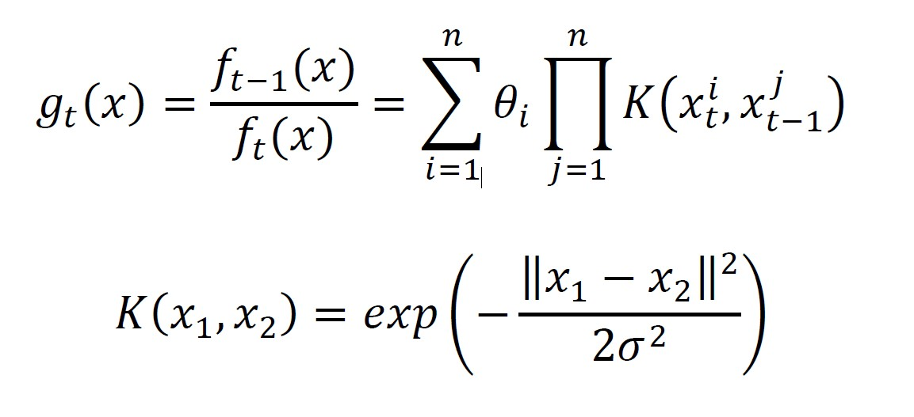
Methodology: SEP Change Point Detection
Two probability densities, f_{t}(x) and f_{t-1}(x) , corresponding to two consecutive windows, each with length n, density ratio-based CPD methods use “dissimilarity measures” as a measure of difference between them to determine whether or not there exists a change point between these two windows.

Slide 26
Parameters Description
Ѳ=(Ѳ₁,…, Ѳ_{n})^{T} represents the set of parameters for the ratio function to be learned from existing data points in the current windows, and σ>0 represents the kernel parameter.
In the training phase, the parameters Ѳ are determined for each window so that a chosen dissimilarity measure is minimized.
Given a density-ratio estimator g_{t}(x), a dissimilarity measure between windows is calculated during the test phase as a change point score.

Slide 27
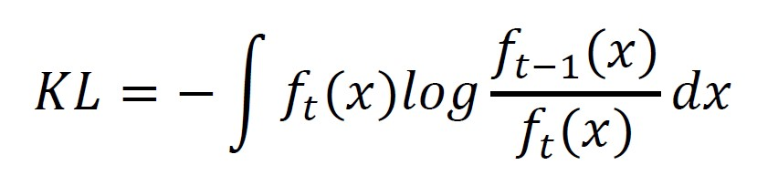
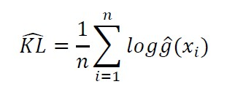
Kullback-Leibler Importance Estimation Procedure (KLIEP)
One of the first direct density ratio CPD methods, the Kullback-Leibler importance estimation procedure (KLIEP) [35], estimates the density ratio using KullbackLeibler (KL) divergence. KL divergence, defined in Equation 5, is a popular choice for the dissimilarity measure
Convex optimization problem
Unique global optimal solution Ѳ can be obtained by a gradient projection method.

Slide 28
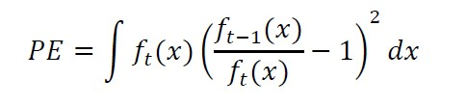
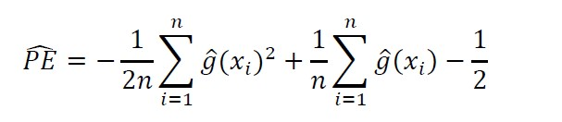
Unconstrained Least-Squares Importance Fitting (uLSIF)
Pearson (PE) divergence as a similarity measure
The density-ratio model is fitted to the true density ratio under the squared loss.

Slide 29
Relative uLSIF (RuLSIF)
The problem of unbounded value of density-ratio balue
α - relative PE divergence for 0≤ α<1 is used as Dissimilarity measure

Slide 30
Result and Findings
In this section, we evaluate our proposed SEP change point detection and compare results with other popular CPD methods
Performance Measures:
G-mean : A supervised learning algorithm that attempts to perform change point detection.
Detection Delay. This directly measures how close the time value of each correctly-predicted CP
is to the actual CP time value in the series.
Artificial Dataset
They have used the three artificial time-series datasets that contain manually inserted change points to show the effectiveness of SEP method in detecting different changes and compare the performance to existing similar method
Dataset 1(Jumping mean)
Dataset 2 (Scaling variance).
Dataset 3 (Changing frequency)

Slide 31
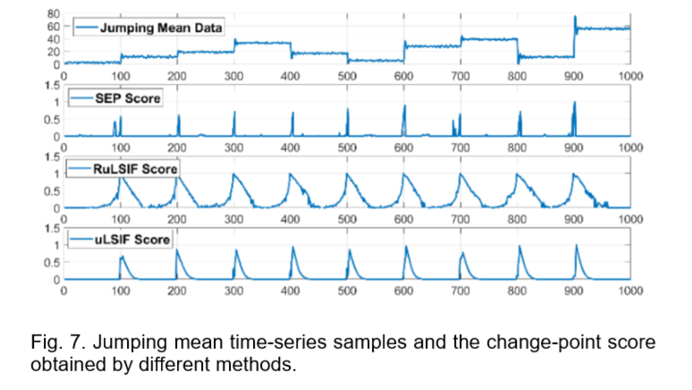
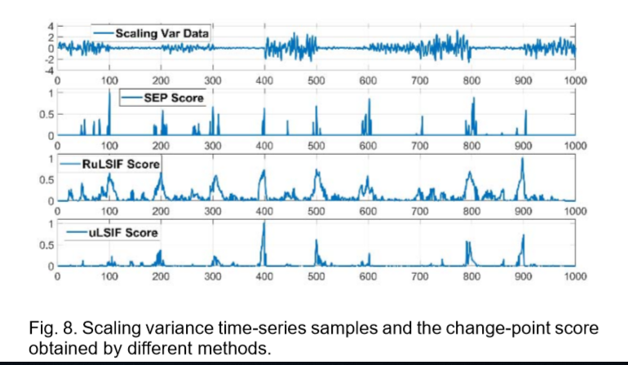
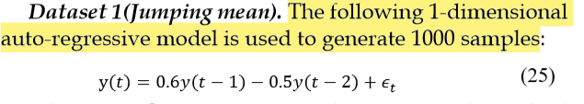
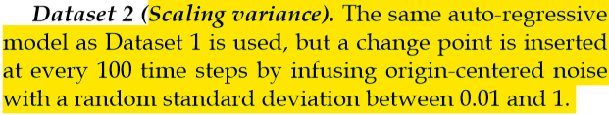
Result and Findings

Slide 32
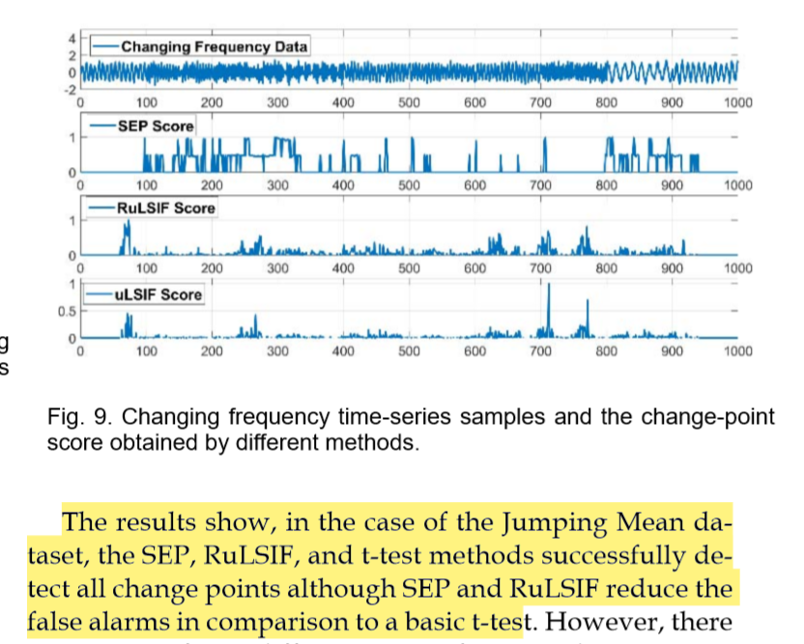
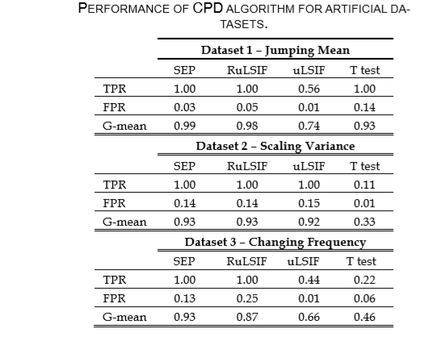
Result and Findings

Slide 33
Project Outline
Title-: Handling Adversarial Attacks on Deep Neural Network through Change Point Detection Application to Smart Home Time Series Data
Key Features –
1. Change Point Detection Application
2. Handling Adversarial Attacks
3. Classification of Activities from Smart Home Time Series Data

Slide 34
Work Flow
RAW Data
Pre-processing
Classify label Data
RAW Data + Noise Attack
Pre-processing
Classify label Data using CPD

